Slide 1
IMBALANCED DATA
Data Mining I – TSD FTMM

Slide 2


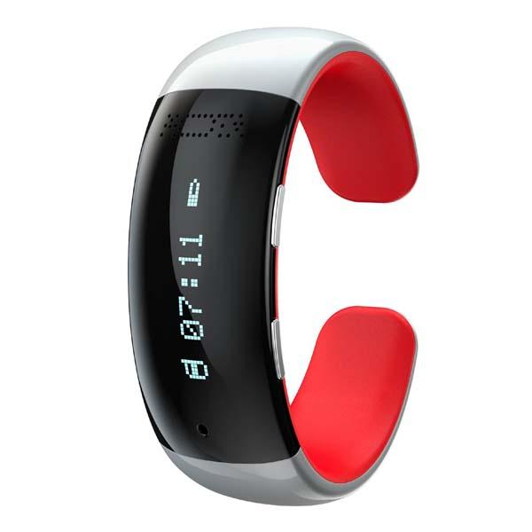

Big amounts of data
With the advent of information technologies the amount of data that is generated everyday is growing at a fast pace.
Trying to extract information and knowledge from that vast cumulus of data is a time consuming (if not impossible) task to do by hand.

Slide 3
Four possibilities that can be used for solving imbalance data problem
Choice of appropriate classifier
Use cost sensitive approach
Use sampling based approach
Bagging

Slide 4
You trained a model to predict cancer from image data using a state of the art Hierarchical siamese CNN with dynamic kernel activations…

Slide 5

Your model has an accuracy of 99.9%

Slide 6

But… WTH!?

Slide 7

By looking at the confusion matrix you realize that the model does not detect any of the positive examples.

Slide 8
After plotting your class distribution you see that you have thousands of negative examples but just a couple of positives.
negatives
positives

Slide 9
Classifiers try to reduce the overall error so they can be biased towards the majority class.
# Negatives = 998
# Positives = 2
By always predicting a negative class the accuracy will be 99.8% !!

Slide 10
Your dataset is imbalanced.
Now what??

Slide 11
What can you do?
Collect more data (difficult in many domains)
Delete data from the majority class
Create synthetic data
Adapt your learning algorithm (cost sensitive classification)

Slide 12
Main idea of sampling based approach is to modify the distribution of events so that the rare class is well represented in the training sample.
There are:
Undersampling
Oversampling
Hybrid oversampling and undersampling

Slide 13
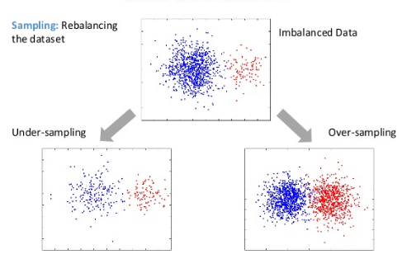
Random over/under sampling
Random oversampling: randomly duplicate data points from the minority class.
Random undersampling: randomly delete data points from the majority class.

Slide 14
Oversampling is replication the events of minority class.
Potential problem: could be for this method is overfitting for noisy data, because noisy data will be replicate.
To avoid overfitting the procedure of randomized oversampling is proposed (SMOTE and Borderline-SMOTE) with cleaning noisy data.
Hui Han, Wen-Yauan Wang, Bing-Huan Mao, Bodeline-SMOTE: A New Over-
Sampling Method in Imbalanced Data Sets Learning, ICIC 2005, part 1, LNCS
3644, 878-887, 2005.

Slide 15
In case of undersampling we can take random sample of majority class.
Potential problem : some of useful instances may not be chosen for training and classifier will not be optimal.
Reduction majority class without losing performance of classification can be used.

Slide 16
Problems with these approaches:
Loss of information (in the case of under sampling)
Overfitting and fixed boundaries (over sampling)

Slide 17
UNDERSAMPLING : Random Under Sampling (RUS), K-means Clustering Centroids (CC), Neighborhood Cleaning Rule (NCL), One-sided Selection (OSS), Nearmiss-1, Nearmiss-2, and Tomek Links
OVERSAMPLING : Random Over Sampling (ROS) and Synthetic Minority Oversampling Technique (SMOTE)
HYBRID : SMOTE + Tomek and SMOTE + ENN (Edited Nearest Neighbors)

Slide 18
Over Sampling Algorithms based on SMOTE
1-SMOTE: Synthetic Minority Over sampling Technique (SMOTE)
2- ADASYN: ADAptive SYNthetic
3- ANS: Adaptive Neighbor Synthetic
4- Borderline SMOTE
5-Safe Level SMOTE
6- DBSMOTE: Density-Based Synthetic Minority Over-sampling Technique

Slide 19
SMOTE
Synthetic Minority Over-sampling Technique (Chawla).
Creates new data points from the minority class.
Operates in the feature space.

Slide 20
Main steps:
Take the difference between a sample point and one of its nearest neighbors.
Multiply the difference by a random number between 0 and 1 and add it to the feature vector.
This causes the selection of a random point along the line segment between two specific features.
synthetic point
a nearest neighbor
sample point

Slide 21
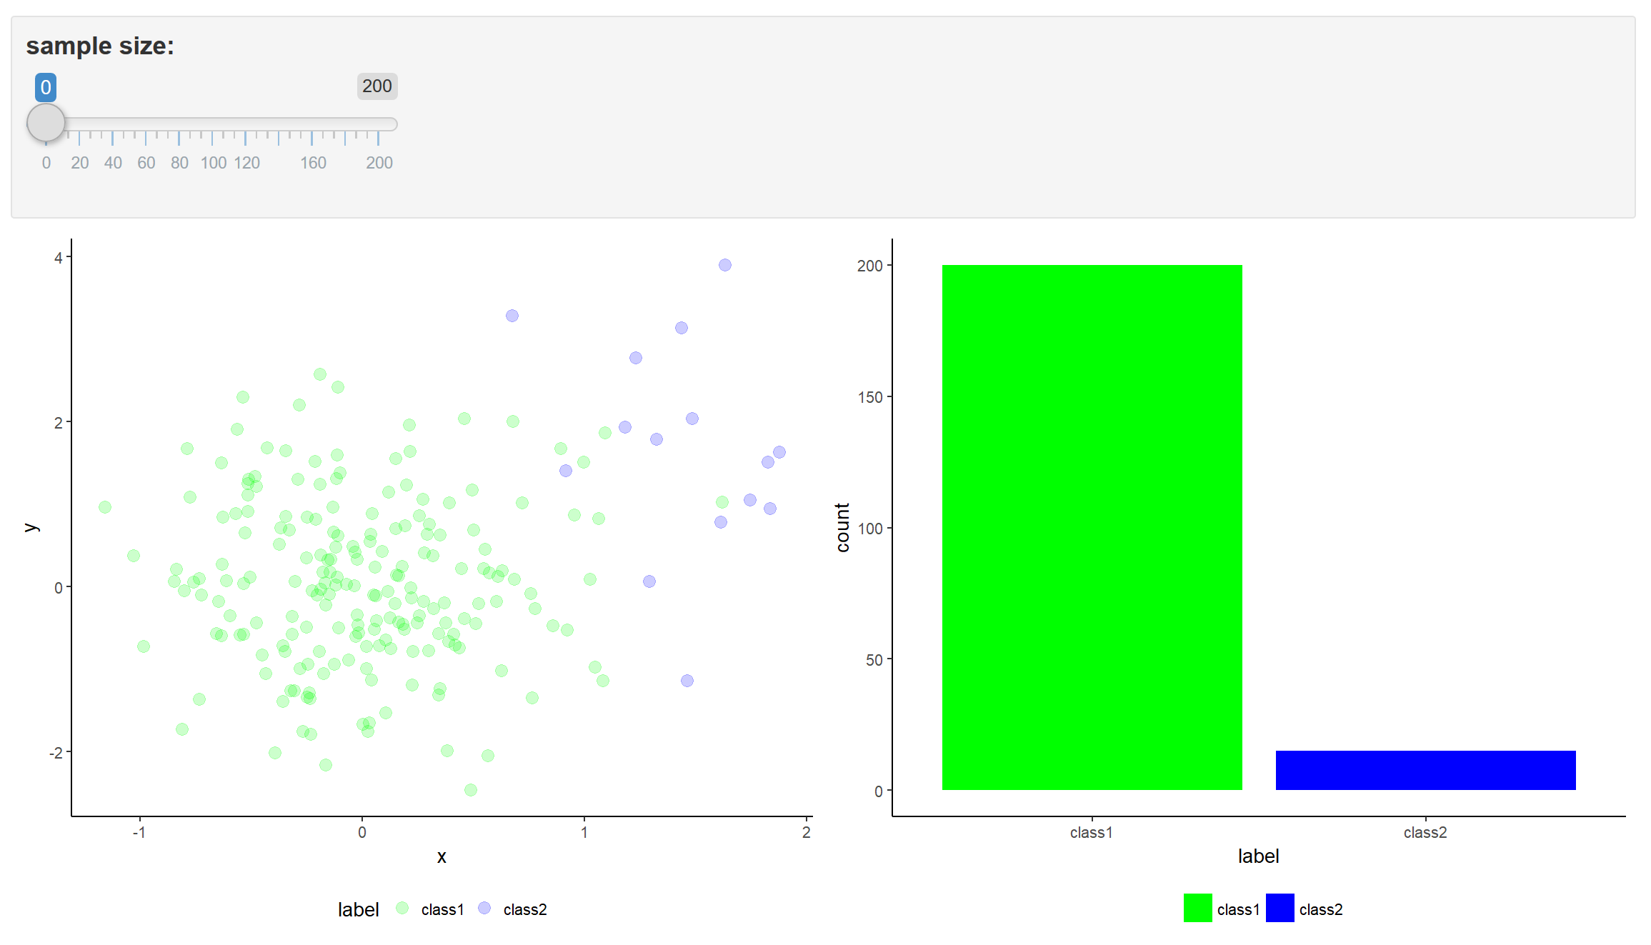
SMOTE DEMO

Slide 22
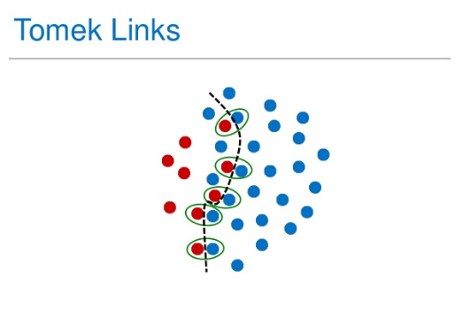
Hybrid oversampling and undersampling
1-SMOTE-Tomek
2-SMOTE-ENN (Edited Nearest Neighbor)

Slide 23

Danger of information injection and overfitting
Do not create synthetic points on the entire dataset before splitting into train/test sets.
Perform the preprocessing just on the training data!!
For k-fold cross validation, you have to do it for each fold (just on the training set).

Slide 24

For images:
Augment training data by applying image transformations: rotate, scale, shift, etc.
Keras provides functionalities for data augmentation: https://blog.keras.io/building-powerful-image-classification-models-using-very-little-data.html

Slide 25
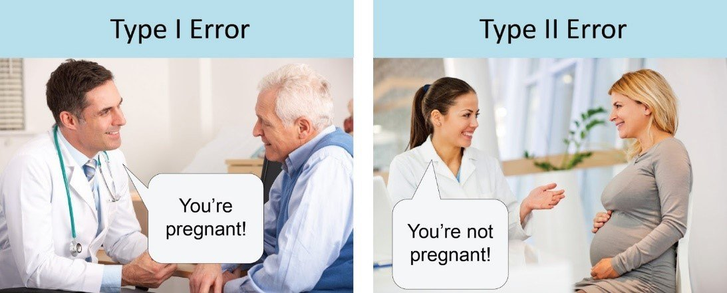
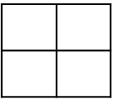
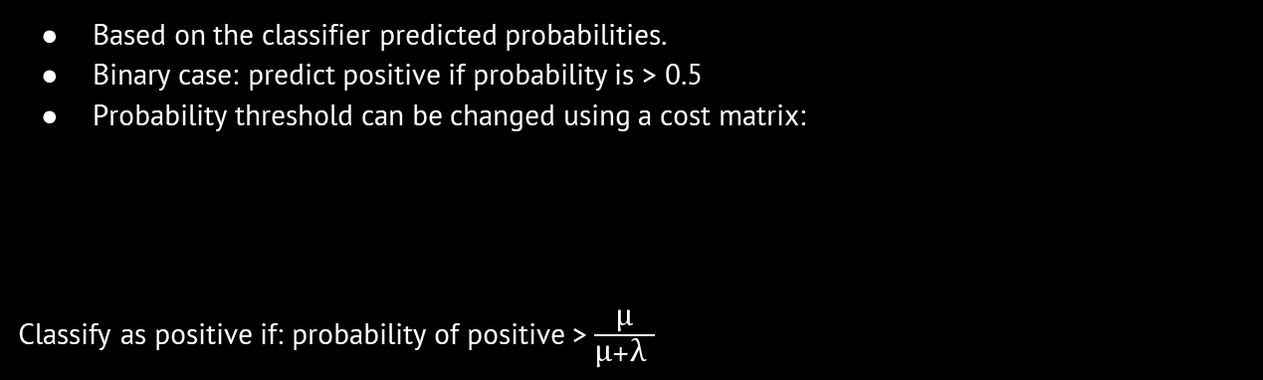
Cost-sensitive learning
Motivation:
Data with different misclassification costs.
Objective: Minimize the total misclassification cost.
Based on the classifier predicted probabilities.
Binary case: predict positive if probability is > 0.5
Probability threshold can be changed using a cost matrix:
Classify as positive if: probability of positive > $\frac{\text{μ}}{\text{μ}+\text{λ} }$
TP: true positives
FN: false negatives
0 | $$λ$$
$$μ$$ | 0
FP: false positives
TN: true negatives

Slide 26
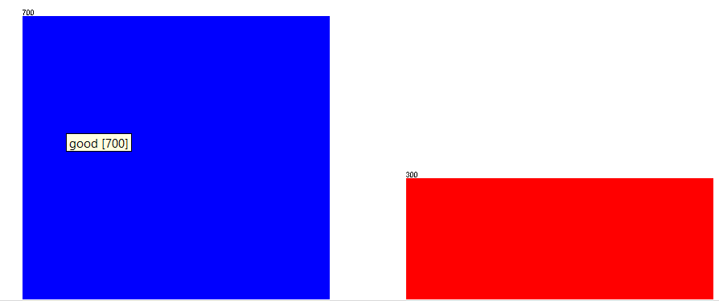
Cost-sensitive classification
Credit dataset.

Slide 27
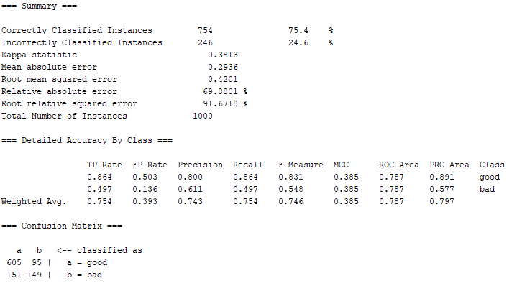
Cost-sensitive classification with Weka
Naïve Bayes.
TP
FN
FP
TN

Slide 28
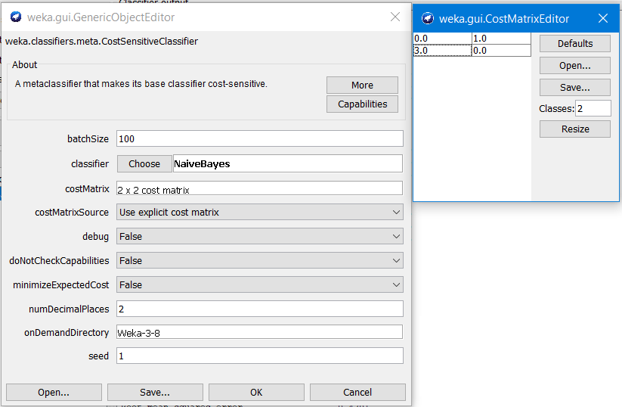

Cost-sensitive classification with Weka
Cost-sensitive classifier with Naïve Bayes.
$$\frac{\text{μ}}{\text{μ}+\text{λ} }=\frac{\text{3}}{\text{3}+\text{1} }=0.75$$
Cost of misclassifications changed from 1.0 to 3.0
FP will be more severely penalized.

Slide 29
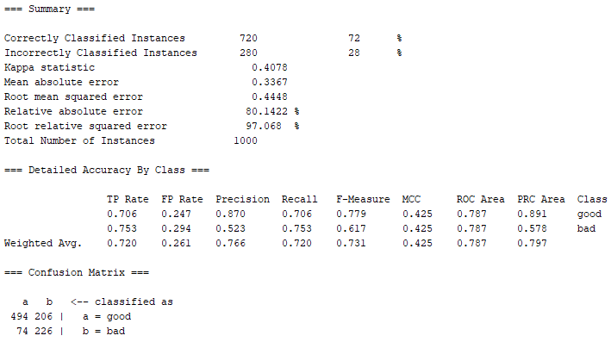
Cost-sensitive classification with Weka
Cost-sensitive classifier with Naïve Bayes.
But also TP reduced
FPs reduced

Slide 30
Assign class weights
In Keras you can assign class weights.
fit() function in keras has a class_weight parameter (see https://keras.io/models/model/).
class_weight = {0: 1.,
1: 9.}
Optional dictionary mapping class indices (integers) to a weight (float) value, used for weighting the loss function (during training only). This can be useful to tell the model to "pay more attention" to samples from an under-represented class
max_v = number of points with majority class
weight_minority = max_v / (# of minority points)
weight_majority = max_v / max_v = 1
This is just one way to compute class weights

Slide 31
Tools
Python imbalanced-learn library: https://github.com/scikit-learn-contrib/imbalanced-learn
Weka also has oversampling methods and a cost sensitive meta classifier: https://weka.wikispaces.com/CostSensitiveClassifier

Slide 32


Performance metrics
Most of the time accuracy will not be enough to assess performance.
accuracy $=\frac{TP+TN}{P+N}$
$sensitivity=\frac{TP}{P}$
precision$=\frac{TP}{TP+FP}$
Percentage of correctly classified instances.
The proportion of positives that are correctly identified as such.
Equivalently, it is the fraction of relevant instances among the selected ones.
Matthews correlation coefficient (takes into account imbalance)

Slide 33

Supporting materials: imbalanced data
Chawla, N. V., Bowyer, K. W., Hall, L. O., & Kegelmeyer, W. P. (2002). SMOTE: synthetic minority over-sampling technique. Journal of artificial intelligence research, 16, 321-357.
Kotsiantis, S., Kanellopoulos, D., & Pintelas, P. (2006). Handling imbalanced datasets: A review. GESTS International Transactions on Computer Science and Engineering, 30(1), 25-36.
SMOTE: https://www.datasciencecentral.com/handling-imbalanced-data-sets-in-supervised-learning-using-family/
Python imbalanced-learn library: https://github.com/scikit-learn-contrib/imbalanced-learn
Weka also has oversampling methods and a cost sensitive meta classifier: https://weka.wikispaces.com/CostSensitiveClassifier
Cost-sensitive classification video: https://www.youtube.com/watch?v=l9muPldOG30
Performance metrics: https://en.wikipedia.org/wiki/Sensitivity_and_specificity

Slide 34
Thanks!
Do you have any questions?

